Slide 1
Azure Purview REST API
Thursday, 21st October 2021

Slide 2

Azure Purview Partner Accelerator Series
aka.ms/purview-accelerate
Data Governance with Azure Purview
Tuesday, 19th October 2021 | 14:00 – 15:00 (GMT +01:00 BST Europe/London)
Azure Purview Workshop (Hands-On)
Wednesday, 20th October 2021 | 09:30 – 15:30 (GMT +01:00 BST Europe/London)
Azure Purview REST API
Thursday, 21st October 2021 | 14:00 – 15:00 (GMT +01:00 BST Europe/London)

Slide 3


UK Azure Partner Technical Community
Are you a member of the UK Azure partner technical community?
The UK Azure Partner Technical Community is designed for like-minded technical professionals within the UK partner community to hear from Microsoft's UK technical teams, and keep informed of the latest events, updates, and news relating to the Azure platform.
We value your support, your collaboration, and your ongoing feedback, and we look forward to your participation in this community created for you!
https://aka.ms/APTC
Join now

Slide 4
Azure Purview API
Apache Atlas

Slide 5
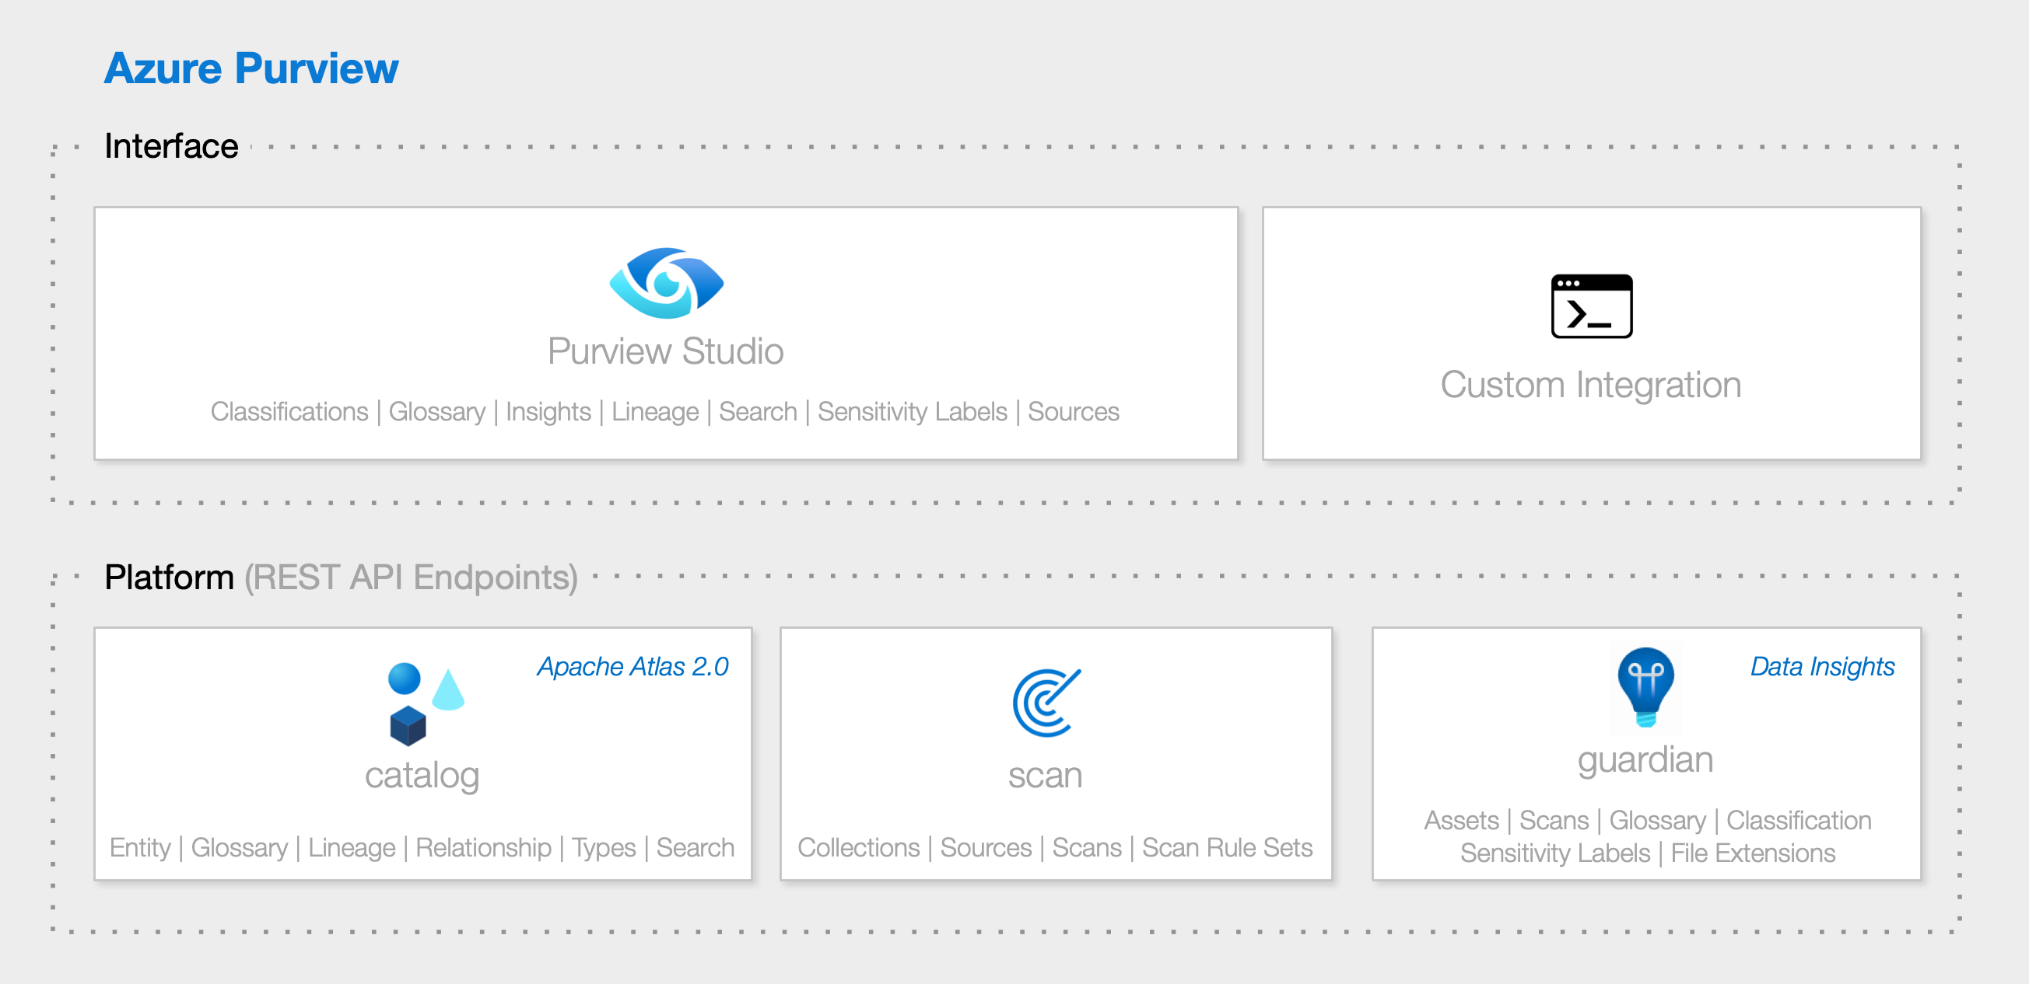

Slide 6
🗺 What is Apache Atlas? "Apache Atlas provides open metadata management and governance capabilities for organizations to build a catalog of their data assets, classify and govern these assets and provide collaboration capabilities around these data assets for data scientists, analysts and the data governance team.“

Slide 7
🕒 Apache Atlas Milestones
2015-01-28 Hortonworks Establishes Data Governance Initiative
2015-05-06 Apache Atlas submitted to the Apache Software Foundation
2017-06-21 Apache Atlas graduates to a Top-Level Project
2018-06-02 Apache Atlas 1.0.0
2019-05-04 Apache Atlas 2.0.0
2020-07-15 Apache Atlas 2.1.0
2021-08-17 Apache Atlas 2.2.0 (Latest)

Slide 8
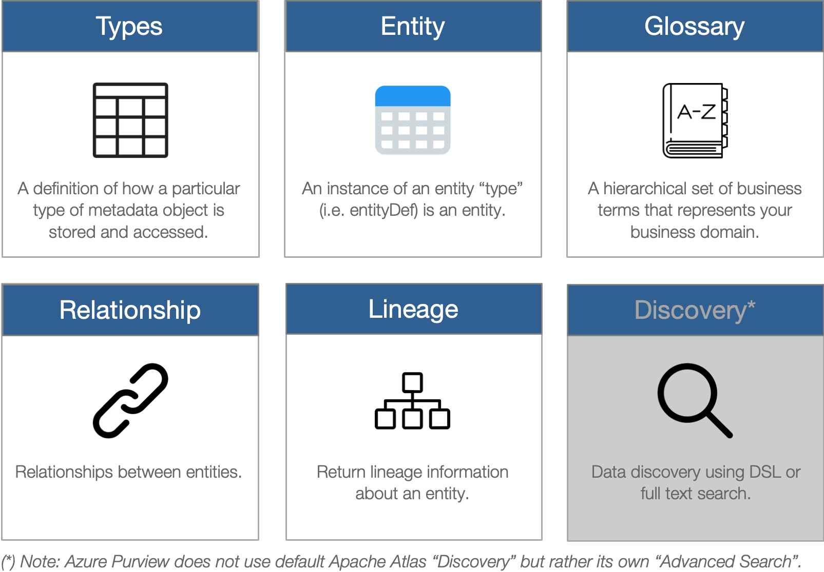
⚙ REST API Endpoints

Slide 9
🚀Getting Started
Create a Service Principal (Client ID, Tenant ID)
Generate a Client Secret
Configure Azure Purview to Trust the Service Principal
Generate an Access Token
You’re ready, read the swagger :)
https://aka.ms/purviewlab > Module 10 (REST API)

Slide 10
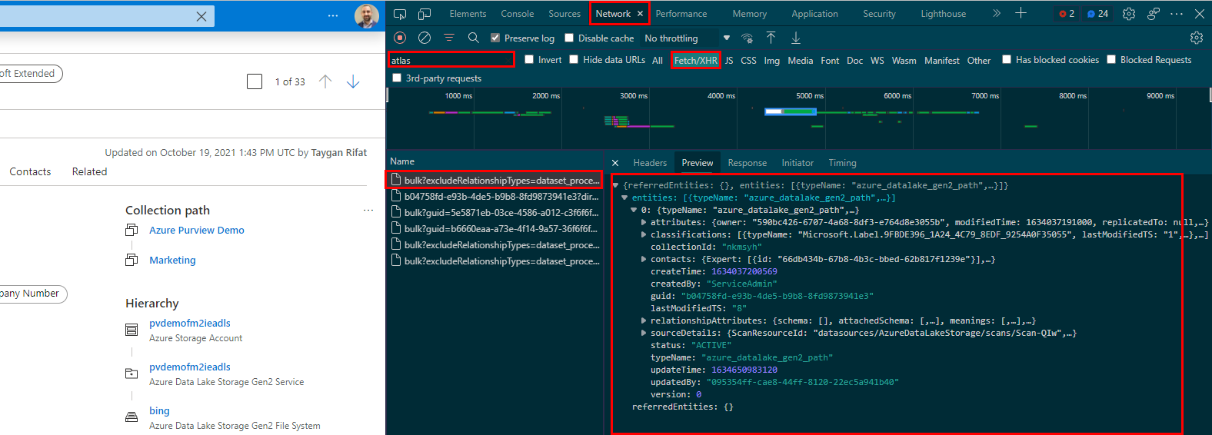
🐱‍💻Reverse Engineer Purview Studio
Navigate to Purview Studio (Edge/Chrome)
Open Developer Tools (F12)
Navigate to Network > XHR
Type “atlas” into the Filter
Start Browsing :)

Slide 11
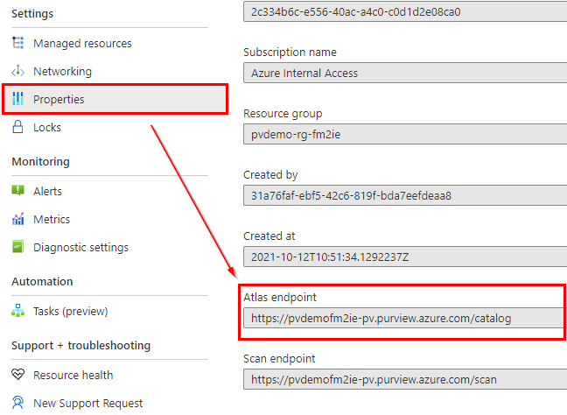
🗺Get Atlas Endpoint
Azure Portal > Purview Account
Properties
Atlas Endpoint

Slide 12
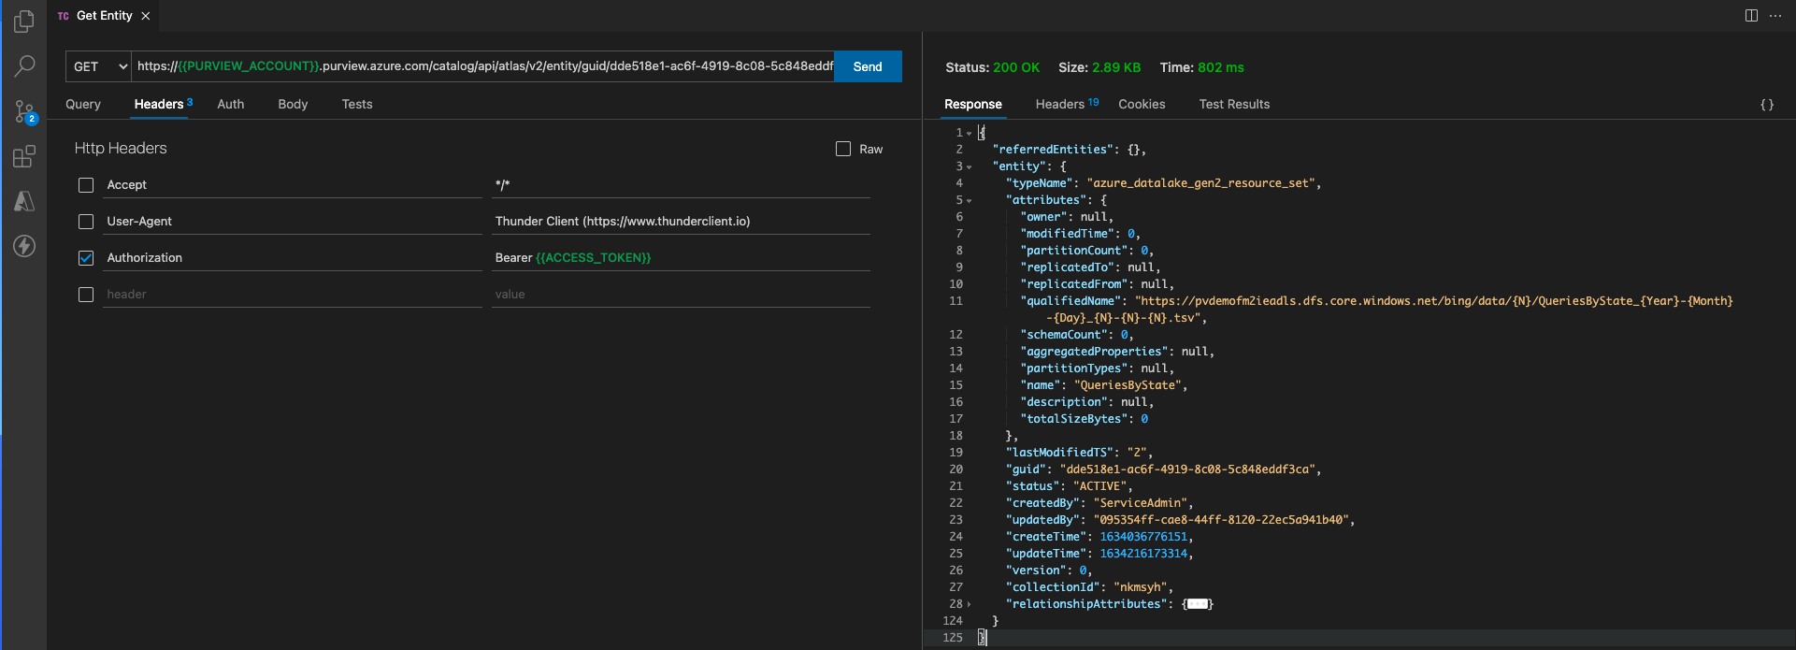
🎮 CRUD with Entities

Slide 13
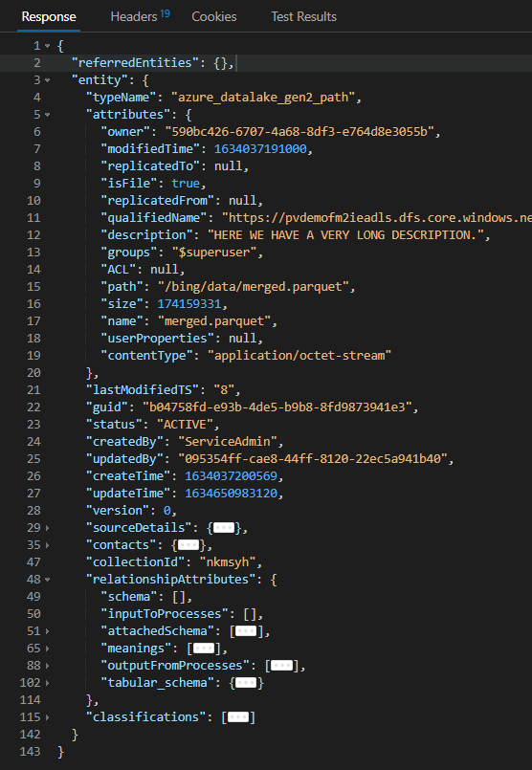
💻Type System
1
2
Referenceable
Attributes qualifiedName replicatedFrom replicatedTo | Relationships meanings
Asset
Attributes name description owner | Relationships meanings
3
4
DataSet
Attributes | Relationships schema inputToProcesses attachedSchema meanings outputFromProcesses tabular_schema
azure_datalake_gen2_path
Attributes path isFile size modifiedTime userProperties contentType ACL owner groups | Relationships schema inputToProcesses attachedSchema meanings outputFromProcesses tabular_schema

Slide 14
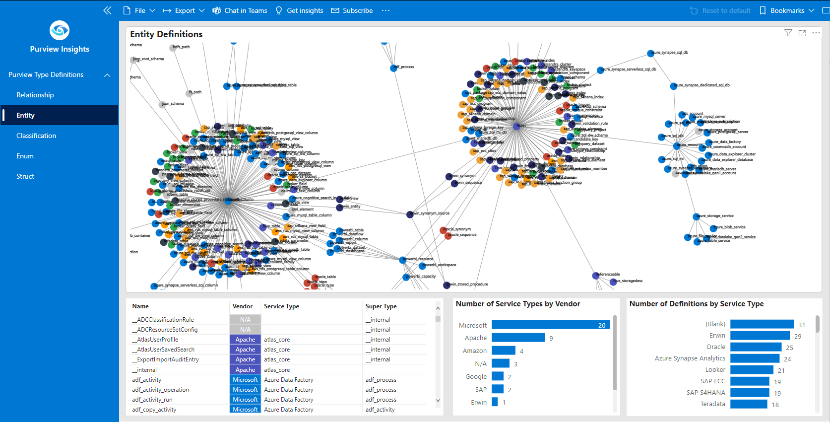
💻Type System

Slide 15
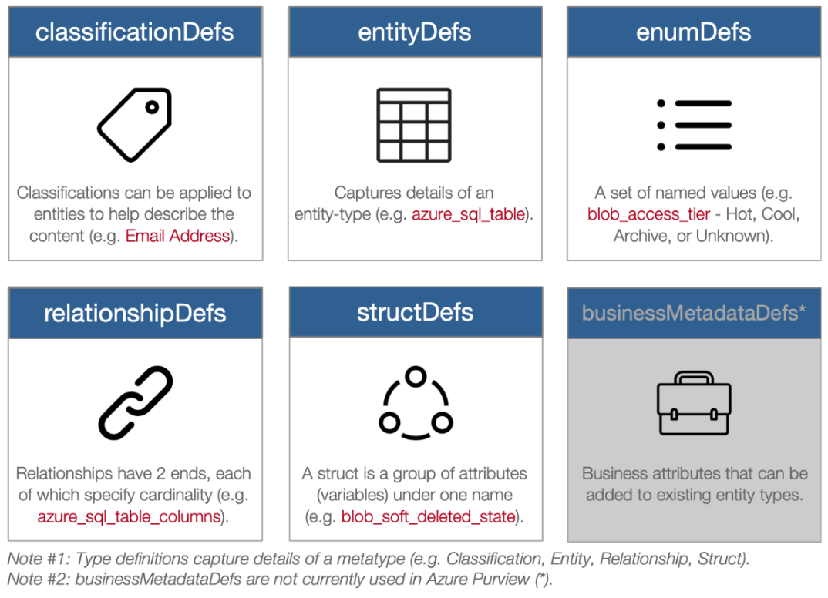
⚙ Type Definitions

Slide 16
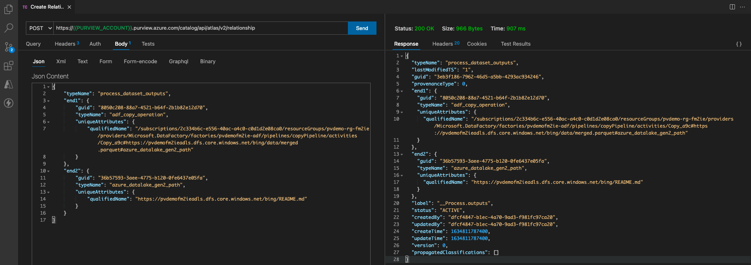
🎮 CRUD with Relationships and Custom Lineage

Slide 17
📚 Additional Resources
[MS Docs] REST APIs for Data Planes
[YouTube] Azure Purview REST API Deep Dive
[GitHub] PyApacheAtlas
[GitHub] purviewcli

Slide 18
Thank You 👋

